Slide 1
IMPORTANT‼️
Download the Participant Resource Folder from Google Drive and Share it with the participants. This is their “Participant Resource Folder” and they will use the contents within it throughout both days of the workshop.

Slide 2
Generative AI’s Impact on Work
Overview
Explore how generative AI can impact business, from automation of routine tasks to augmentation of knowledge workers. Understand key use cases across industries and business functions.
Learning Objectives
Identify the key benefits and potential applications of Generative AI for work.
Analyze the impact of Generative AI on various industries and business functions.

Slide 3
Suggested Agenda (1 hour)
0:00-0:10 Course Introduction
0:10-0:40 The Impact of Gen AI on Work
0:40-0:55 Generative AI: What is it Good For?
0:55-0:60 Reflection
*these are estimates - timings will vary!

Slide 4
Teaching Guide:
Use the following quick tips for instructional guidance.
Title | What to Do
Learning Objective Slides | Pause to unpack the learning objectives and prime students for the lesson. This is a crucial step in the learning process and gives participants time to build context and activate any prior knowledge.
Solo Activities | For solo activities, you can choose to put people in group breakout rooms (to create the “table” group that they would be in in a physical setting) or allow students to work independently in the main session.
Group and Partner Discussions and Exercises (Remote) | Creating Breakout Rooms — Group and Partner Exercises Set up breakout rooms for pairs/groups. Broadcast directions and discussion questions to all breakout rooms. At the 60-seconds-left mark, broadcast a message to all rooms: “Start to wrap up your discussions. Rooms will close in one minute!” Move around from breakout room to breakout room to “walk around the classroom.”
Group and Partner Discussions and Exercises (In Person) | Facilitating Group and Partner Discussions and Exercises — Live Classroom Arrange the room prior to the session to create a conducive environment for group work. Provide clear, concise instructions verbally and on a handout or slide for the exercise, ensuring that all participants are aware of the goals and the time allocated. Circulate around the room to engage with groups Display a timer or announce when there is 1 min remaining Facilitate the sharing of group conclusions or discussion points with the whole class, ensuring that each group has a voice.

Slide 5
Welcome!
Applied Generative AI
Workshop

Slide 6

YOUR GA TEAM
Lead Facilitator
[Name]
[Bio]
Associate Facilitator
[Name]
[Bio]

Slide 7
WHAT’S IN IT FOR YOU?
Learn the fundamentals of generative AI and its ethical implications.
Discover how AI can revolutionize business communication, and bring insight and visualization to your data.
Gain hands-on experience with tools like ChatGPT to improve your workflows.
Notes:
PURPOSE: Introduce learners to the benefits and applications of generative AI in professional settings.
TALKING POINTS:
Explain the key concepts of generative AI, including how it differs from other AI types.
Discuss the transformative impact of AI on business communication, planning, and innovation.
Highlight the importance of hands-on learning to effectively utilize AI tools like ChatGPT
CHANGELOG 2024-01-26: modified to make more relevant.

Slide 8
GENERATIVE AI: A RAPIDLY EVOLVING DOMAIN
Like generative AI models, this workshop has "Knowledge Cut-offs"
As models like ChatGPT get pre-trained at a moment in time, their last update determines their knowledge cut-off.
The workshop also has a cut-off - it should be up-to-date as of January 26th 2024.
Notes:
PURPOSE: Clarify the concept of knowledge cut-offs in AI models and the importance of continuous learning.
TALKING POINTS:
Define what a 'knowledge cut-off' is and its significance for AI model relevance.
Ensure understanding of the workshop's currency with the latest AI advancements.
CHANGELOG 2024-01-26: modified to make clearer - we should change this on the master version, too.

Slide 9
HOW THE DAY WILL FLOW
Six packed hours: Mix of lectures, hands-on practice, group activities, and Q&A.
Breaks and lunch: Short breaks between each unit, with 1 hour for lunch.
Notes:
PURPOSE: Outline the structure of the workshop to manage participant expectations for the learning experience.
TALKING POINTS:
Emphasize the comprehensive nature of the workshop, spanning over two full days for in-depth coverage.
Describe the variety of daily activities designed to cater to different learning styles and preferences.
Detail the schedule, including breaks and lunch, to ensure participants can plan their time and stay energized.
CHANGELOG 2024-01-26: modified to be a six hour workshop.

Slide 10
Workshop Agenda
Part One | Part Two
🫱🏼‍🫲🏾 Introductions (15 mins) | 🥘 Lunch (20 mins)
🤖 Generative AI’s Impact on Work (45 mins) | 🧐 Generative AI For Data Analysis (1 hour)
🦾 Capabilities & Limitations (45 mins) | 📈 Identifying Trends and Insights (30 mins)
☕️ Break (5 mins) | ☕️ Break (5 mins)
📝 Prompt Optimization (45 mins) | 👁 Data Visualizations with Al (1.5 hours)
Notes:
PURPOSE: Outline the structure of the workshop to manage participant expectations for the learning experience.
TALKING POINTS:
Emphasize the comprehensive nature of the workshop, spanning six topics.
Detail the schedule, including breaks and lunch, to ensure participants can plan their time and stay energized.
CHANGELOG 2024-01-26: modified to show the six lessons.

Slide 11
CLASS NORMS
Participation: Engage actively, share experiences, and ask questions.
Collaboration: Work together, respect differing viewpoints.
Communication: Listen actively, provide constructive feedback.
Seek Help: Don't hesitate to ask instructors or peers for clarification or assistance.
Notes:
PURPOSE: Establish a positive and productive learning environment by defining behavioral expectations.
TALKING POINTS:
Stress the importance of active engagement through participation, sharing, and inquiry.
Highlight the value of teamwork and the respect for diverse perspectives in collaboration.
Emphasize the role of effective communication, including active listening and providing constructive feedback.
Encourage a supportive culture where seeking help is seen as a strength, not a weakness.

Slide 12
ICE BREAKER 🧊
Share your name, your role, and one non-work-related fact about yourself that you're comfortable sharing with the group.
What's one question or topic about AI that you find particularly intriguing or want to know more about?
Notes:
PURPOSE: To give participants a chance to interact and get familiar with each other before the workshop officially starts.
TEACHING TIPS:
You can do this as a whole-group activity, or form breakout rooms for the ice breaker depending on the size of your cohort.

Slide 13
Generative AI’s Impact on
Work

Slide 14
LEARNING OBJECTIVES
Identify the key benefits and potential applications of Generative AI for work.
Analyze the impact of Generative AI on various industries and business functions.

Slide 15
The Impact of Gen AI on Work

Slide 16
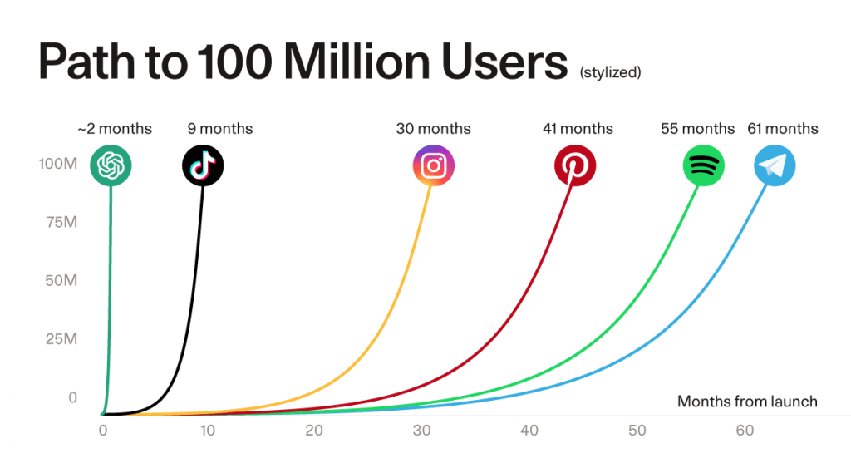
Why Now? The Incredible Growth of ChatGPT
ChatGPT
Source: Sequoia Capital
Notes:
PURPOSE: This slide is included to set the stage for why Generative AI is a hot topic right now, highlighting its rapid adoption and market penetration.
TALKING POINTS:
ChatGPT reached 100 million users in just two months, outpacing other big names like TikTok, Instagram, and Spotify.
This rapid growth isn't just a fluke; it's a sign of the sudden maturity of large language models and their applications.
Logos from left to right:
ChatGPT, TikTok, Instagram, Pinterest, Spotify, Telegram
TEACHING TIPS:
Ask the audience when they first used ChatGPT
Ask them what their first thoughts were of ChatGPT when they first used it.
Pose a quick question like "Why do you think ChatGPT gained users so quickly?" to engage the audience and gather initial thoughts on AI's capabilities.

Slide 17
AI is quite possibly the most important – and best – thing our civilization has ever created, certainly on par with electricity and microchips, and probably beyond those.
Marc Andreessen, Co-founder Andreessen Horowitz
Notes:
PURPOSE: This slide aims to underscore the transformative potential of AI, aligning it with other game-changing technologies like electricity and microchips to deepen our understanding of its potential business applications and impact.
TALKING POINTS:
Marc Andreessen is no stranger to technological revolutions, having been involved in shaping the internet.
He equates the potential of AI to groundbreaking advancements like electricity, suggesting AI could power a fourth industrial revolution.
However, it's important to approach the hype with a balanced view, given that not all hyped-up technologies live up to their promises.
TEACHING TIPS
Marc Andreeson created the first widely used web browser, Mosaic, and so has seen multiple hype cycles before. And yet he is arguing the that AI will power a fourth industrial revolution after those of steam, electricity, and information technology.
While we should remain sceptical about any hyped up technology - remember NFTs? - we think it may not be quite so fanciful to imagine that the impact on the world of work could ultimately be as huge as the internet, ecommerce, or even the humble spreadsheet.

Slide 18

AI is quite possibly the most important – and best – thing our civilization has ever created, certainly on par with electricity and microchips, and probably beyond those.
Marc Andreessen, Co-founder Andreessen Horowitz
Take a few moments to reflect… what is your reaction to this quote?
Type your response in the chat.
Notes:
PURPOSE: This slide aims to underscore the transformative potential of AI, aligning it with other game-changing technologies like electricity and microchips to deepen our understanding of its potential business applications and impact.
TALKING POINTS:
Marc Andreessen is no stranger to technological revolutions, having been involved in shaping the internet.
He equates the potential of AI to groundbreaking advancements like electricity, suggesting AI could power a fourth industrial revolution.
However, it's important to approach the hype with a balanced view, given that not all hyped-up technologies live up to their promises.
TEACHING TIPS
Marc Andreeson created the first widely used web browser, Mosaic, and so has seen multiple hype cycles before. And yet he is arguing the that AI will power a fourth industrial revolution after those of steam, electricity, and information technology.
While we should remain sceptical about any hyped up technology - remember NFTs? - we think it may not be quite so fanciful to imagine that the impact on the world of work could ultimately be as huge as the internet, ecommerce, or even the humble spreadsheet.

Slide 19
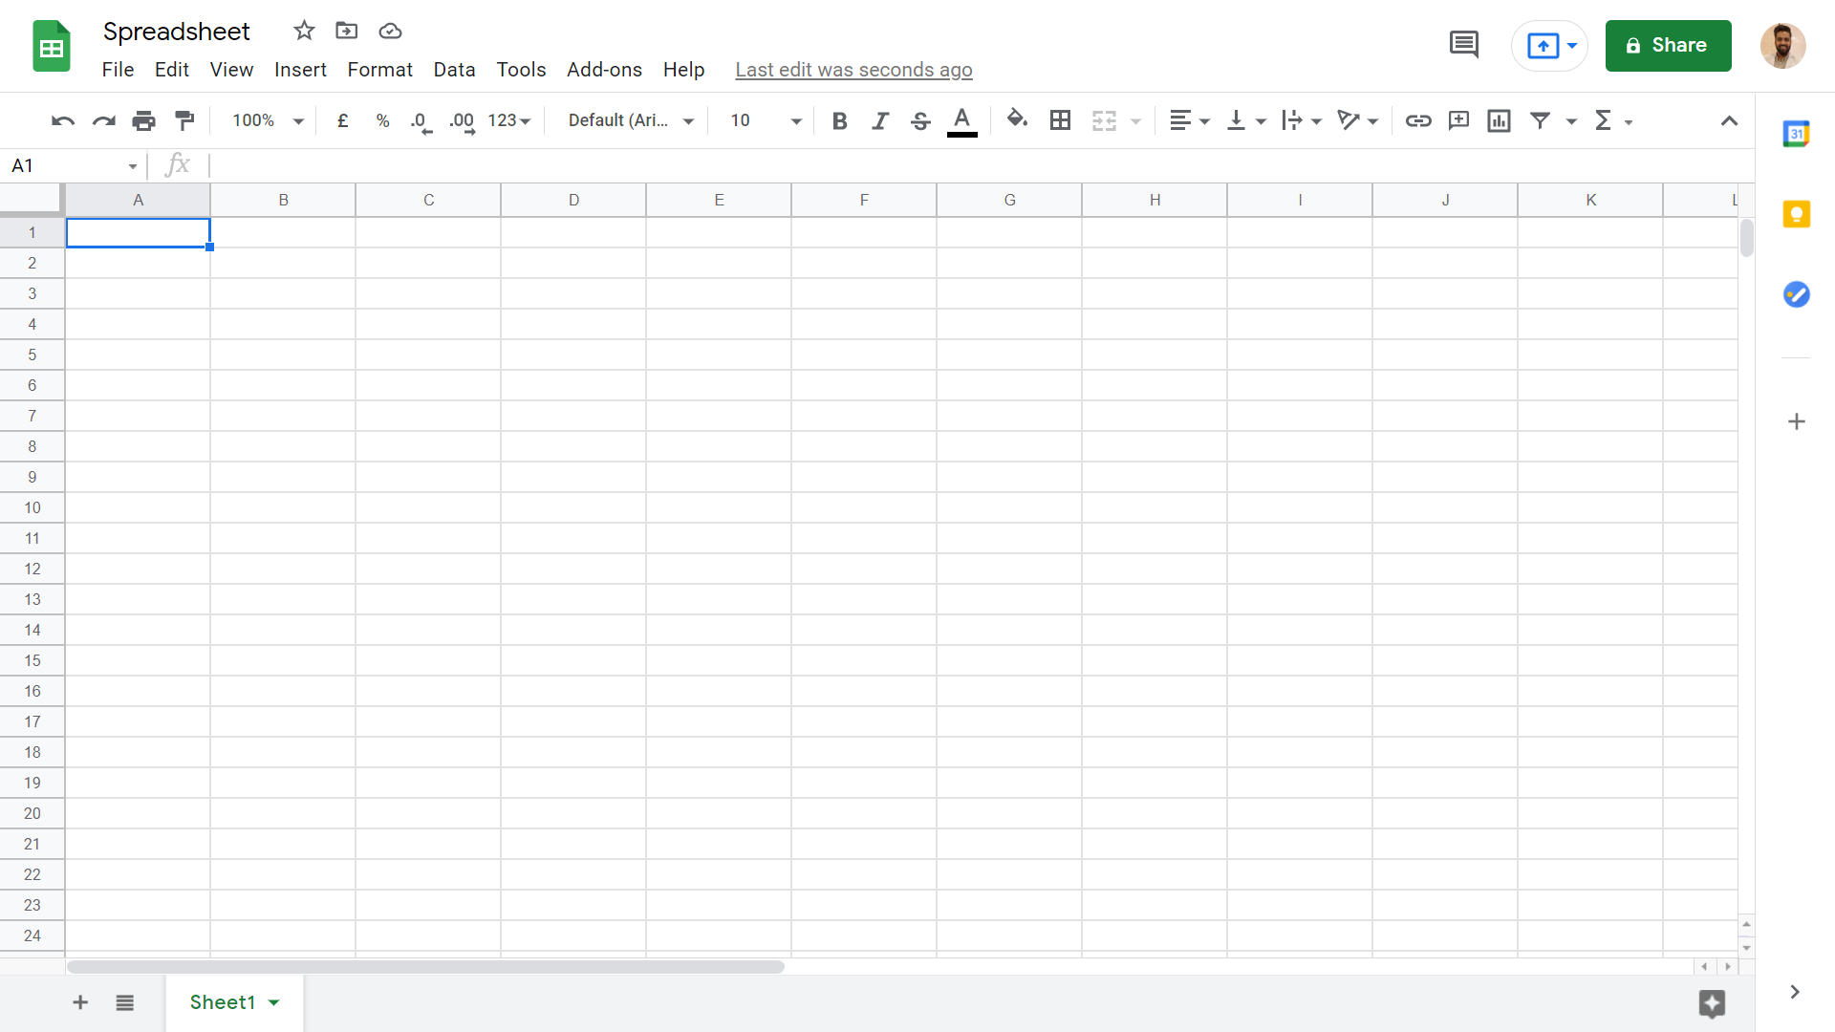
Let’s Consider a Previous Technological Revolution…
The spreadsheet
Notes:
PURPOSE
To set the stage for the next two slides that elaborate on the impact of the spreadsheet.

Slide 20

The Impact of the Spreadsheet
1960s: Insurance clerks represent single spreadsheet cells (see below)
1970s: Mainframes automate away this work
1980s: Desktop spreadsheets (VisiCalc)
1990s: Spreadsheets for everyone - offices never looked the same
Image: “The Apartment” (1960), Directed by Billy Wilder
Source: Office, messaging and verbs — Benedict Evans
Notes:
Source: Office, messaging and verbs — Benedict Evans
In the image, taken from a 1960s film, each Insurance Clerk is the equivalent of a cell in a spreadsheet. PURPOSE: Show how spreadsheet software evolved and changed business productivity. Consider: is generative AI this century’s spreadsheet?
TALKING POINTS:
In the 1960s, insurance clerks were like spreadsheet cells, with communication through physical mail and typing.
In the 1970s, mainframes allowed department-level spreadsheets, accessed via a terminal.
VisiCalc brought spreadsheets to desktop PCs in the 1980s, but only for specialists.
By the 1990s, Excel made spreadsheets ubiquitous, changing business productivity.
TEACHING TIPS:
Ask the audience to share examples of how spreadsheets changed business processes.
Note how software evolved from replicating existing workflows to enabling new workflows.

Slide 21
Generative AI could be this century’s spreadsheet.

Slide 22

Boston Consulting Group
5 Minutes
An experiment in using GPT-4 to augment consulting work
A randomized control trial involving hundreds of consultants found that those with access to GPT-4 outperformed those without in eighteen different tasks for a fictional shoe company, across metrics like time, task completion, and output quality.
GPT-4 empowered consultants were more efficient and produced higher-quality work in creative, analytical, and writing tasks.
Both AI and human graders rated assisted work as higher quality.
Notes:
PURPOSE:
This slide aims to illustrate the tangible impact of AI, specifically GPT-4, on enhancing the efficiency and quality of consulting work, aligning with our learning goal of understanding AI's role in the modern workplace.
TALKING POINTS:
- Emphasize the rigour of the study, with randomised control trials and diverse tasks involved.
- Highlight that both human and AI graders agreed on the superior quality, strengthening the results.
- Engage the audience with the interactive element, inviting them to guess the performance improvement percentage (shown after the mentimeter poll)
TEACHING TIPS:
- Consider asking for audience guesses before revealing any actual percentages, to engage them and gauge their expectations.
- If possible, have real-time polling (e.g. using Menti.com) to capture audience guesses on the performance boost, and reveal the actual figure afterward.
Source: Centaurs and Cyborgs on the Jagged Frontier
758 consultants from Boston Consulting Group were randomly assigned to either proactively use GPT 4.0, or were blocked from doing so.
They were given 18 different tasks representative of the type of work done at an elite management consulting firm.
Consultants using AI finished 12.2% more tasks on average, completed tasks 25.1% more quickly, and produced 40% higher quality results than those without. A huge effect.

Slide 23
Think About It: Performance Boost 🤔
Guess the performance boost (%) for consultants when working with GPT-4
Type your response in the chat.
Notes:
PURPOSE: Encourage participants to think critically about the impact of AI tools on productivity in the consulting industry.
TALKING POINTS:
Invite speculation on how AI like GPT-4 might enhance consultant efficiency and effectiveness.
Discuss the factors that contribute to performance improvement when using AI tools.
Explore expectations vs. reality in terms of productivity gains with AI assistance.
TEACHING TIPS:
You could have participants guess in bands - 10-20%, 20-30%, 30-40%, etc.
Encourage sharing of personal experiences or observations related to AI in their work.
Use this as an opportunity to discuss the importance of measuring performance and setting realistic benchmarks for AI integration.

Slide 24
Consultants using GPT-4
Versus the control group
+40%
The consultants who scored the worst initially had the biggest jump in their overall performance:
43%
+25%
higher quality results.
+12%
quicker task completion
more tasks finished
Notes:
PURPOSE: This slide provides concrete numbers on how GPT-4 improves consultant performance, driving home our learning objectives of identifying key benefits and analysing AI's cross-industry impact.
TALKING POINTS:
Focus on the 43% performance jump for the initially lower-scoring consultants, illustrating GPT-4's role in elevating baseline performance.
Emphasise the 40% improvement in quality, showing that GPT-4 not only speeds up work but enhances it.
Discuss the 25% and 12% boosts in task completion and speed, suggesting that AI can optimise multiple facets of work.
TEACHING TIPS:
Use the percentages as a talking point to delve into the real-world implications. For example, "What would a 40% improvement in quality mean for your business?"
Source: Centaurs and Cyborgs on the Jagged Frontier
758 consultants from Boston Consulting Group were randomly assigned to either proactively use GPT 4.0, or were banned from doing so.
They were given 18 different tasks representative of the type of work done at an elite management consulting firm.
Consultants using AI finished 12.2% more tasks on average, completed tasks 25.1% more quickly, and produced 40% higher quality results than those without. A huge effect.

Slide 25
Human/AI Collaboration
5 Minutes
A Field Experiment on HR Recruiters
Researchers found that while higher-quality AI improved task efficiency in HR recruitment, it led to reduced human engagement and poorer decision-making
More experienced recruiters performed significantly better when given a lower quality AI assistant.
This "falling asleep at the wheel" effect suggests that maximising AI performance alone may not yield the best outcomes in human-AI collaborations.
Notes:
Source: Falling Asleep at the Wheel: Human/AI Collaboration in a Field Experiment on HR Recruiters
In another experiment, this time in the field of HR, researchers found that while higher-quality AI improved task efficiency in HR recruitment, it led to reduced human engagement and poorer decision-making, particularly among experienced recruiters. They became much more careless, overly reliant on the tool, and less trusting in their own judgment.
Interestingly, the more experienced recruiters performed significantly better when given a lower quality AI assistant.
This "falling asleep at the wheel" effect suggests that maximising AI performance alone may not yield the best outcomes in human-AI collaborations.
PURPOSE: This slide serves as a cautionary note, urging attention and oversight even when AI is involved, advancing our objectives of understanding AI’s nuanced impact on businesses and human roles.
TALKING POINTS:
Highlight the tension between increasing AI accuracy and diminishing human effort in decision-making.
Point out that experienced recruiters were more susceptible to "falling asleep at the wheel" with high-quality AI, illustrating that the issue isn't just for newcomers.
Discuss how the study underscores the complexity of designing human-AI collaborations that enhance rather than dilute human skills and engagement.
TEACHING TIPS:
Use this slide to segue into real-world applications, asking, “How could your company be at risk of 'falling asleep at the wheel' with AI?”

Slide 26
Don’t fall asleep at the wheel.
Notes:
Source: Falling Asleep at the Wheel: Human/AI Collaboration in a Field Experiment on HR Recruiters
In another experiment, this time in the field of HR, researchers found that while higher-quality AI improved task efficiency in HR recruitment, it led to reduced human engagement and poorer decision-making, particularly among experienced recruiters. They became much more careless, overly reliant on the tool, and less trusting in their own judgment.
Interestingly, the more experienced recruiters performed significantly better when given a lower quality AI assistant.
This "falling asleep at the wheel" effect suggests that maximising AI performance alone may not yield the best outcomes in human-AI collaborations.
PURPOSE: This slide serves as a cautionary note, urging attention and oversight even when AI is involved, advancing our objectives of understanding AI’s nuanced impact on businesses and human roles.
TALKING POINTS:
Highlight the tension between increasing AI accuracy and diminishing human effort in decision-making.
Point out that experienced recruiters were more susceptible to "falling asleep at the wheel" with high-quality AI, illustrating that the issue isn't just for newcomers.
Discuss how the study underscores the complexity of designing human-AI collaborations that enhance rather than dilute human skills and engagement.
TEACHING TIPS:
Use this slide to segue into real-world applications, asking, “How could your company be at risk of 'falling asleep at the wheel' with AI?”

Slide 27
Generative AI: What is it Good For?

Slide 28
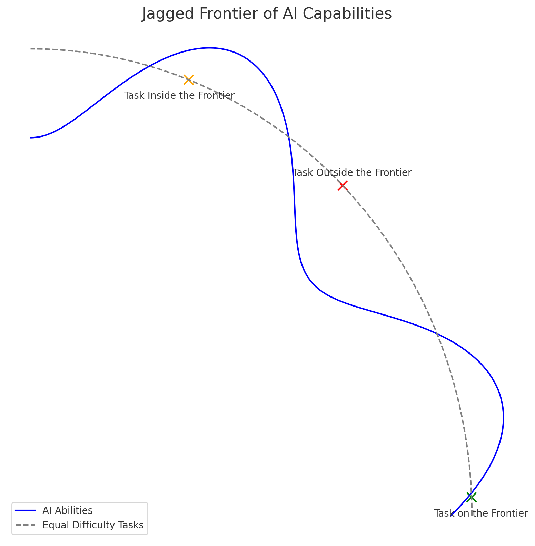
Working out which tasks are suitable for Gen AI (and which aren’t)
Generative AI is not good at everything.
It is surprisingly good at some tasks (“inside the frontier”) and terrible at other tasks (“outside the frontier”), which seem to be of equal difficulty for a human.
Source: Centaurs and Cyborgs on the Jagged Frontier
Notes:
PURPOSE:
To delineate between tasks that are suitable for Generative AI ("inside the frontier") and those that aren't ("outside the frontier").
TALKING POINTS
• Generative AI excels in certain tasks that might appear challenging even for humans, placing them "inside the frontier."
• On the other hand, there are tasks which seem to be of equal difficulty for humans but remain outside the capabilities of AI.
• The 'Jagged Frontier' illustrates the dynamic boundary of AI capabilities and helps us identify where AI can be effectively implemented.
TEACHING TIPS
• Use real-world examples to illustrate tasks that Generative AI can and cannot perform.
• Engage the audience by asking them to guess where certain tasks might fall on the 'Jagged Frontier.'
• Highlight that the frontier is ever-evolving with advancements in AI research and technology. Source: Centaurs and Cyborgs on the Jagged Frontier by Ethan Mollick, Associate Professor at the Wharton School of the University of Pennsylvania.
Prompt used to create the image:
Hey GPT, I want you to create an image to illustrate our new
paper on the effects of Al and work. And the key element of the
paper is the idea of a jagged frontier. That Al capabilities are
uneven and so tasks that seem to be of equal difficulty, some of
those tasks will be just outside the frontier, some of the tasks will
be inside. So I want you to create an image with whatever
technique you want that shows a jagged frontier extending from a
center point where the distance from the center indicates the
difficulty of a task. And to show tasks that can be represented by
points, for example, one just inside the wall of the frontier, one
just outside the wall of the frontier, and one task labeled task
outside the frontier, the other labeled task inside the frontier, and
there will be a line, a circular line, showing that they are the same
distance from the center, therefore the same difficulty level.

Slide 29
How can we figure out the tasks that fall inside, and outside, of the frontier?
Type your response in the chat.
Source: Centaurs and Cyborgs on the Jagged Frontier
Notes:
PURPOSE: Guide participants to understand and identify the capabilities and limitations of AI in various tasks.
TALKING POINTS:
Describe how to assess AI capabilities and limitations based on current technological advancements.
Discuss the criteria that determine whether a task lies within the AI's capabilities (the 'frontier') or beyond it.
TEACHING TIPS:
Encourage participants to think about the complexity and requirements of different tasks.
Prompt discussion on how the frontier of AI capabilities is constantly expanding with new developments.

Slide 30
Some Business Applications of Generative AI
Writing
Working with Data
Working with Documents
Idea Generation
Notes:
Throughout the course of this workshop we’re going to look at four key applications of generative AI - this is not an exhaustive list, but where we think we can add most value to your day to day.
PURPOSE:
Provide an overview of current uses of AI, focusing on writing, data, documents, and ideation.
TALKING POINTS:
Writing: AI can write drafts, improve existing text, help with email and documentation, and unblock writers. But beware of hallucinations.
Working with Data: Tools like ChatGPT can analyze data sets and create visualizations, even working from scans or images of data. But we always need to double-check critical information.
Working with Data: Whether it’s summarising or synthesising documents, or using AI to generate presentations, plans, reports, or analyses - we still need to keep a critical eye.
Idea Generation: Finally, we can use AI to get creative, whether it’s brainstorming, using strategic or creative frameworks, or helping visualise new products or services.
TEACHING TIPS:
Ask attendees to share examples of how they could apply AI in these areas. What other use cases come to mind?

Slide 31
Breakout Rooms
For the next activity:
Move participants to breakout rooms of 3-4
Make sure you present the corresponding menti slide so the participants can see the directions.

Slide 32
Tasks at Work
10 Minutes
Reflect for a moment, then take turns discussing the following:
What tasks do you perform weekly? Reporting? Planning? Communicating?
How much time do you spend on email? In meetings? In chat?
How would you estimate you spend your time each week?
What tasks do you struggle to achieve?
What tasks do you not have enough time for?
What tasks take up time without delivering value?
Of the tasks you’ve considered, which ones would you like to use ChatGPT for?
Notes:
PURPOSE: One sentence about why this slide is included/how it gets us closer to our learning goals.
TALKING POINTS
This is a suggested talking point for instructors.
Bullets are better than paragraph-y scripts.
TEACHING TIPS
Have a suggestion for what an instructor should do while teaching to this slide? Put it here!
This is an optional section. Not all slides require facilitation tips.

Slide 33
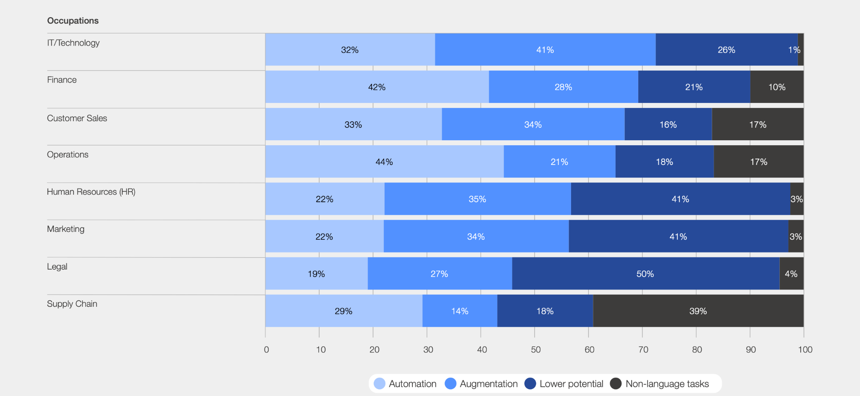
Exposure of Business Functions to LLMs
Source: Jobs of Tomorrow: Large Language Models and Jobs
Notes:
Source: Jobs of Tomorrow: Large Language Models and Jobs
PURPOSE:
To illustrate the extent to which different business functions are exposed to the capabilities of LLMs in terms of automation, augmentation, potential, and non-language tasks.
TALKING POINTS:
- IT/Technology leads in automation and augmentation, closely followed by Finance. The potential for LLMs in these areas is promising.
- Customer Sales sees a substantial exposure to augmentation at 34%. The curious aspect? There's also a significant portion (16%) of tasks in this area that LLMs might not cater to, potentially due to the non-language nature.
- Human Resources, while traditionally considered a 'people' function, showcases 35% exposure to augmentation. A testament to how technology is revolutionizing even the most human-centric roles.
- Legal, an area of meticulous precision, exhibits a 50% lower potential for LLM use, possibly due to the specific nuances and complexities involved.
- Supply Chain holds a surprising 39% in non-language tasks. Delving into the 'why' can open a discussion on the intricacies of this field.
TEACHING TIPS:
- Highlight the difference between 'automation' and 'augmentation'. While the former is about replacing tasks, the latter is about enhancing human capabilities.
- Engage the audience with a question: "Why do you think the Legal department has a 50% lower potential for LLM use compared to other functions?"
- Encourage students or participants to discuss real-life examples in their respective fields, fostering relatability and real-world applicability.

Slide 34
Reflection
For the next activity:
Ask participants to reflect on their own, either in their own heads or by jotting down notes
If they would like to share their reflections, let them know they can do so in the Zoom chat

Slide 35
Your Tasks at Work

Slide 36
Reflection: Your Tasks at Work
1
How do you think generative AI will affect the skills required for jobs in the next decade?
2
Reflect on how generative AI might impact job security and the nature of employment. What are your thoughts and feelings about these changes?
Notes:
- Ask participants to reflect on their own, either in their own heads or by jotting down notes
- If they would like to share their reflections, let them know they can do so in the Zoom chat

Slide 37
AI won’t replace humans, but humans with AI will replace humans without AI
Karim Lakhani, Professor at Harvard Business School

